Slide 1
Threaded Gradient-Based Edge Detection (An Image Segmentation Model)
BY :
MD MUSTAFA ALI

Slide 2
Why image segmentation?

Slide 3
In computer vision, Image processing is a very rich research field, and the most important field in image processing is image segmentation.
Many applications of Image Segmentation –
Medical Imaging - diagnosis for cancer
Autonomous Driving – In self-driving cars, semantic segmentation is popularly used to help the system identify and locate vehicles and other objects on the road.
Image to Text Converters – image segmentation plus deep learning

Slide 4
Literature Survey
Image segmentation has always been the one of the HOT research topics [1]. The very first method and also the simplest method is Thresholding [2]. It converts a grey-scale image into a binary image. Nobuyuki Otsu developed an algorithm known as Otsu’s Thresholding which perform the image thresholding automatically [3].
Edge detection techniques uses gradient operators for finding the edges. Many researchers researched and came up with different gradient operators in the form of masks. Lawrence Roberts (1965) introduced Robert Edge Detector, Sobel in 1970 (Rafael C.Gonzalez (2004)) gave Sobel Operator [4], Prewitt in 1970 (Rafael C.Gonzalez) proposed Prewill Edge Detector [4], Kirsch edge detection is introduced by Kirsch (1971) [5], Laplacian of Gaussian (LoG) was proposed by Marr(1982) which was the second order gradient of an image [6].

Slide 5
Continued…
John Canny at MIT in 1983 proposed Canny Gradient Edge Detector which turned out to be the most promising image segmentation model at that time and still it outperforms many of the newer image segmentation algorithms that have been developed. This method separates noise from the image before finding edges of the image [7,8].

Slide 6
Techniques of Image Segmentation
Thresholding
Region Based Segmentation
Edge Detection and segmentation
Watershed Technique
and many more….

Slide 7
Problem Statement
Development of Efficient Threaded Gradient Edge Detector image segmentation Model

Slide 8
Objectives
Study Canny gradient Edge Detector Model and implement its serial variant in C++.
Look for the scope of parallelisation
Develop the parallel variant using OpenMP.
Compare the results of serial and parallel variant with different test images

Slide 9
Why Canny Gradient Edge Detector?

Slide 10
Because it is the most promising image segmentation model and still it outperforms many of the newer image segmentation algorithms that have been developed.

Slide 11
Canny Gradient Edge Detector
It used edge detection and segmentation approach
Algorithm:
Convolve image f(r, c) with a Gaussian function to get smooth image g(r, c)
g(r, c)=f(r , c) * G(r,c,6)
Apply first difference gradient operator to compute edge strength then edge magnitude and direction are obtain as before.
Apply non-maximal or critical suppression to the gradient magnitude.
Apply threshold to the non-maximal suppression image.

Slide 12
Scope for Parallelisation
Canny gradient edge detector is a 4 step process and in each step operation are performed on each pixel separately.
So, we can divide the pixels into groups and assign each group a thread to perform the operations

Slide 13
Parallel Algorithm
In the step 1 (Gaussian Filter Step), we have used for directive to divide the work among threads, we have used static scheduling with chunk size equals to number of pixels by number of threads. We have also used collapse clause because each iteration is independent and also the inner loop does not depend upon the outer loop.
In the step 2 (Gradient Step), we have parallelized the loop same way as in step 1, we have used collapse(2) to do the parallelism up to depth 2.
Step 3 (Non-Maximal Suppression Step) is also parallelised in the same way as step1 and step2.
Step 4 (Thresholding Step) this step is little bit different, since we are obtaining the histogram of the pixels so each pixel uses shared memory that is the histogram array, so we have additionally added critical directive to avoid race conditions. While, calculating the threshold value using Otsu’s method, we do not parallelised it because it is a constant time operation (256 iterations), so making it parallel only increases time.

Slide 14
Runtime Analysis
Steps | # of Operations | Upper-bound Time Complexity
Gaussian Blur | 2n²k² | O(n²k²)
Gradient Step | c n²k² | O(n²k²)
Non-Maximal Suppression | cn² | O(n²)
Thresholding | n² + c + cn² | O(n²)
Total | (2+c) n²k² +(1+2c) n² + c | O(n²k²)

Slide 15
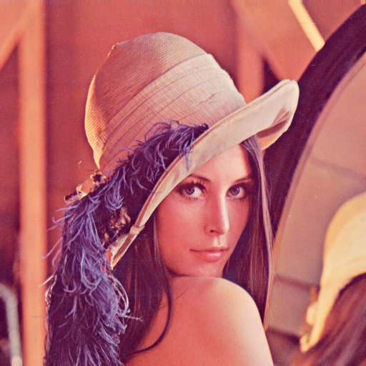
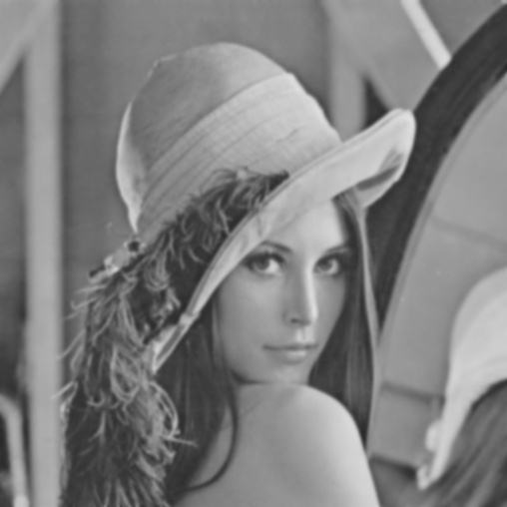
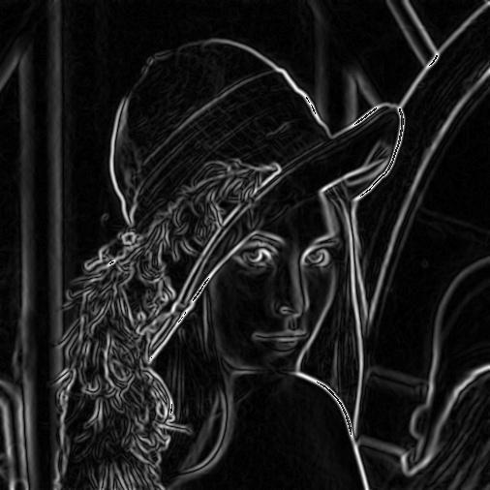
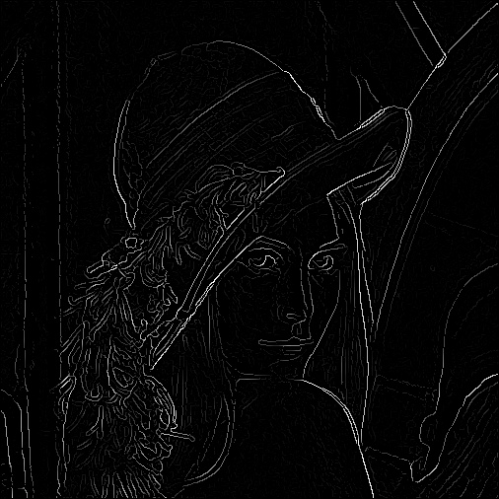
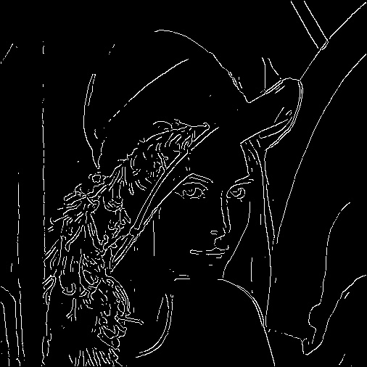
Results

Slide 16
Serial v/s Parallel
# of Pixels | Serial Runtime (in seconds) | Using 4 threads (in seconds) | Using 8 threads (in seconds)
262144 | 0.153305 | 0.059072 | 0.038292
1098680 | 0.65355 | 0.20342 | 0.150593
1222000 | 0.677445 | 0.235107 | 0.164807
262144 | 0.157378 | 0.058714 | 0.040456
42177408 | 25.074825 | 8.381755 | 5.542515
22118400 | 12.922088 | 4.29609 | 2.961152
16634880 | 9.736989 | 3.267065 | 2.236372
100000000 | 59.789911 | 18.680413 | 13.43038
74927472 | 43.868485 | 14.520308 | 10.419266
157774500 | 94.755757 | 30.829906 | 21.85261

Slide 17
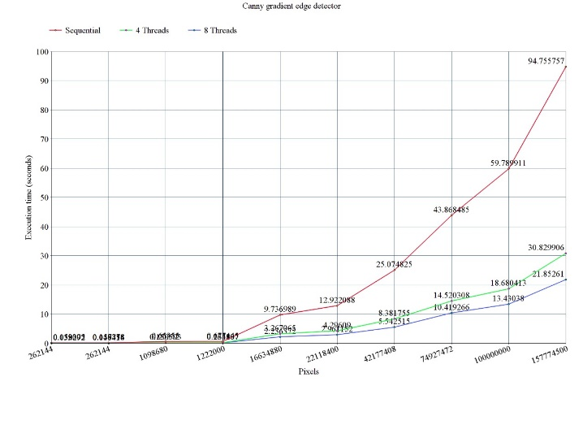
Comparison Graph

Slide 18
Conclusion
We can see the graph, the execution time of serial algorithm is growing exponentially at a very high rate as the number of pixels increases where as execution time of parallel algorithm also increases exponentially but at a very low rate. So, from the above results, we conclude Parallel Canny Gradient Edge Detector performs far better than the serial model.

Slide 19
Future Work
Semantic segmentation is the combination of image segmentation and Convolutional Neural Network (CNN) which is used to detect and label objects. The segmented image is fed into the Deep CNN which is flattened in each step and then finally converted into a vector which is then fed into a logistic regression model which classifies the object in the image. So, the Parallel Canny Gradient Edge detector can be used here as the image segmentation model.

Slide 20
Tools Required
Microsoft Visual Studio (IDE)
C++ (Language)
OpenCV (For performing operations on Image)
OpenMP (Parallel Programming)

Slide 21
References
[1] K. K. Singh, A. Singh, “A Study Of Image Segmentation Algorithms For Different
Types Of Images,” IJCSI International Journal of Computer Science Issues, Vol. 7, Issue 5, September 2010
[2] M. Sezgin & B. Sankur (2004). "Survey over image thresholding techniques and quantitative performance evaluation". Journal of Electronic Imaging.
[3] Nobuyuki Otsu (1979). "A threshold selection method from gray-level histograms". IEEE Trans. Sys. Man. Cyber.
[4] Rafael C. Gonzalez, Richard E. Woods & Steven L. Eddins (2004) Digital Image Processing Using MATLAB, Pearson Education Ptd. Ltd, Singapore.
[5] Kirsch, R. (1971) “Computer determination of the constituent structure of biological images”, Computers and Biomedical Research, 4, 315–328.
[6] Marr, D & E. Hildreth (1980) “Theory of edge detection”, Proc. Royal Society of London, B, 207, 187–217.
[7] Canny, J. F (1983) Finding edges and lines in images, Master's thesis, MIT. AI Lab. TR-720.
[8] Canny, J. F (1986) “A computational approach to edge detection”, IEEE. Transaction on Pattern Analysis and Machine Intelligence, 8, 679-714.

Slide 22
Thank You

